Slide 1
Project CASA: Final Project Presentation
May 25, 2017
Yevgeniya Chekh, Jan Kohout, David Löffler, Miroslav Rudišin, Kryštof Sýkora, Marek Szeles, Ho Minh Thanh

Slide 2
Presentation agenda
Introduction, what is CASA?
Review formal project outputs
Project run overview
Lessons learned, individual reviews

Slide 3
Who are we?
Team Role | Name | Contact
Project Lead | Marek Szeles | szelemar@fel.cvut.cz
Analyst | Ho Minh Thanh | homintha@fel.cvut.cz
Head of Development | David Löffler | loffldav@fel.cvut.cz
Head of Testing | Kryštof Sýkora | sykorkry@fel.cvut.cz
Developer | Miroslav Rudišin | rudismi1@fel.cvut.cz
Developer | Jan Kohout | kohouj13@fel.cvut.cz
Tester | Yevgeniya Chekh | chekhyev@fel.cvut.cz

Slide 4
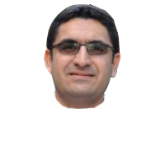
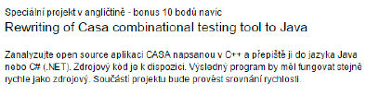
What is CASA?
Dr. Bestoun S. Ahmed 

Slide 5
So… Is CASA a success?
Yes!
No!
Jein?!

Slide 6
Why?
Meetings: 16
Steering Workshops held: 5 (so far)
Documents created: x
Spanning over: x pages
Lines of code worked on: 323 198

Slide 7
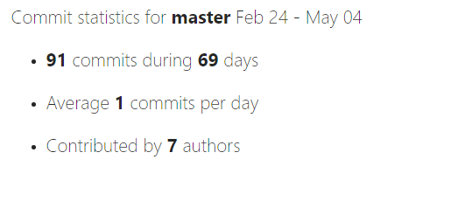
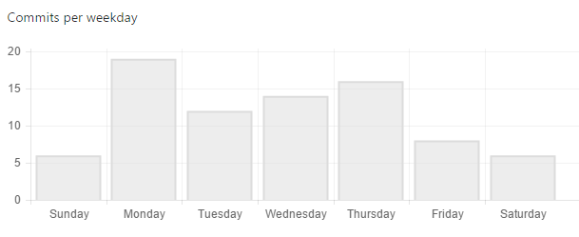
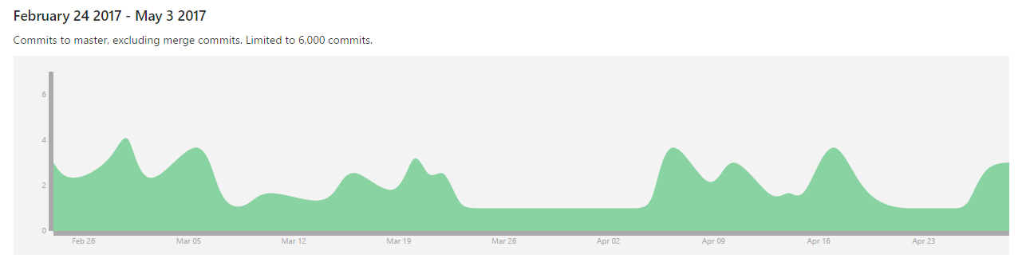
Also why?

Slide 8
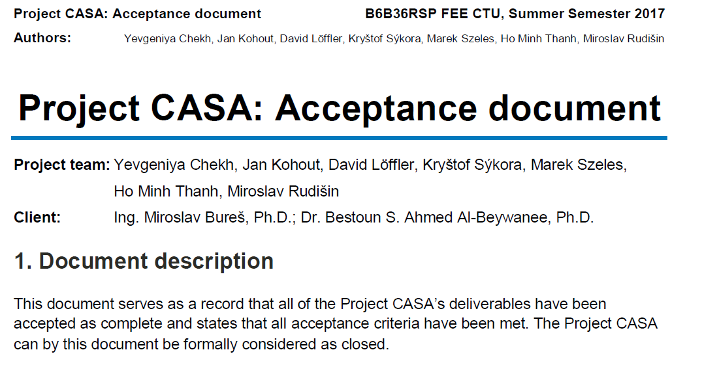
And finally…

Slide 9
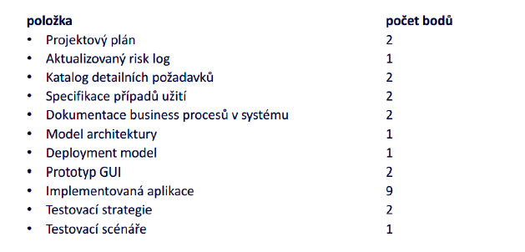
Let‘s take a look at the official rules though:
1
2
3
4
5
6
7
8
9
10
11

Slide 10
Let‘s take a look at the official rules though:
1
2
3
4
5
6
7
8
9
10
11

Slide 11
Project plan
Completed
1

Slide 12
Risk log
Completed
2

Slide 13
Detailed requirements specification
Completed
3

Slide 14
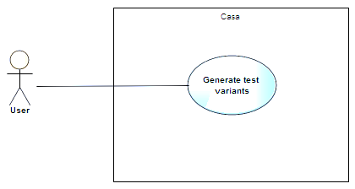
Use case specification
Completed
4

Slide 15
Architecture model v1
Completed
6

Slide 16
Architecture model v2
Completed
6

Slide 17
Deployment model
Completed
7

Slide 18
Application – Acceptance + Change of scope
Change of scope
9
Accepted current result, next steps TBD

Slide 19
Business processes; GUI; Testing strategy: Out of project scope/other solution
Out of scope
5
8
10
11
Not relevant for project
(accepted)

Slide 20
Project plan - expectation

Slide 21
Project plan - reality

Slide 22
Deep Dive: Analytics

Slide 23
Analysis – What are we doing?
First step: Read the documentation - success
Second step: Understand the documentation – failed
Third step: Ask Bestoun S. Ahmed - success

Slide 24


Analysis - Full Project View
1
2.1
2
1.1
1.2
2.2
1.3
1.5
1.4
Legend
1.7
Header file
1.6
C file
3
Dependency
3.1
3.2

Slide 25
Analysis – We don‘t want to reinvent wheels.
What modules can we run in C++? – None
Are there modules in Java we can use? – Yes, SAT

Slide 26
Deep Dive: Development

Slide 27
Development progress
Starting with package with least dependencies
CASA
1
3
1
2
casa
2
3
common
minisat
1.1
1.1
1.5
1.5
2.1
2.1
3.1
algorithms
io
posix
3.1
solver
1.2
1.2
1.6
1.6
2.2
2.2
3.2
annealing
sat
utility
3.2
include
1.3
1.7
1.3
1.7
covering
search
1.4
1.4
events
Main.C

Slide 28
Full Project View: Starting point
1
2.1
2
1.1
1.2
2.2
1.3
1.5
1.4
Legend
Not started
1.7
1.6
In progress
3
Finished
3.1
3.2
Change request

Slide 29
Full Project View: 16.3.2017
1
2.1
2
1.1
1.2
2.2
1.3
1.5
1.4
Legend
Not started
1.7
1.6
In progress
3
Finished
3.1
3.2
Change request

Slide 30
Full Project View: 20.4.2017
1
2.1
2
1.1
1.2
2.2
1.3
1.5
1.4
Legend
Not started
1.7
1.6
In progress
3
Finished
3.1
3.2
Change request

Slide 31
Full Project View: 4.5.2017
1
2.1
2
1.1
1.2
2.2
1.3
1.5
1.4
Legend
Not started
1.7
1.6
In progress
3
Finished
3.1
3.2
Change request

Slide 32
Full Project View: Current status
1
2.1
2
1.1
1.2
2.2
1.3
1.5
1.4
Legend
Not started
1.7
1.6
In progress
3
Finished
3.1
3.2
Change request

Slide 33
Deep Dive: Testing

Slide 34
Testing
Input x output comparison
Unit testing for development support
Complications:
Could not build system
Unable to test beyond a certain degree of focus
Further testing and strategies

Slide 35
Final individual reviews, Lessons learned

Slide 36
Lessons learned
Introduction, what is CASA?
Review formal project outputs
Project run overview
Lessons learned, individual reviews

Slide 37
Old slides

Slide 38
Project is being steadily updated…

Slide 39
…and we are still within planned schedule
Feb
Mar
Apr
May
Activity
08
09
10
11
12
13
14
15
16
17
18
19
20
21
Project Scope Analysis
CASA Architecture Mapping
Documentation Creation
Development in Java
Testing
SteerCo Meetings
Milestones
23. Feb 2017
Team Assembly
02. Mar 2017
Proposal Agreement
16. Mar 2017
Start of
Development
27. Apr 2017
Testing Phase
25. May 2017
Final outcome
hand-in
We are
here
Rector day off

Slide 40
Today we need to:
Resolve change requests
Discuss translation problems
Revise testing strategy
We would like to implement some changes to the original code in the two parsing modules
See attachment (ChR: Parsing Analysis)
Some problems have arisen during code translation
In some modules, test stubs are already in place -

Slide 41
Development update

Slide 42
Development progress
CASA
1
2
3
casa
common
minisat
1.1
1.5
2.1
3.1
algorithms
io
posix
solver
1.2
1.6
2.2
3.2
annealing
sat
utility
include
1.3
1.7
covering
search
1.4
events
Main.C

Slide 43
Full Project View: Last meeting (20.4.2017)
1
2.1
2
1.1
1.2
2.2
1.3
1.5
1.4
Legend
Not started
1.7
1.6
In progress
3
Finished
3.1
3.2
Change request

Slide 44
Full Project View: Current status (4.5.2017)
1
2.1
2
1.1
1.2
2.2
1.3
1.5
1.4
Legend
Not started
1.7
1.6
In progress
3
Finished
3.1
3.2
Change request

Slide 45
Testing update

Slide 46
High-level View
CASA
1
2
3
casa
common
minisat
1.1
1.5
2.1
3.1
algorithms
io
posix
solver
1.2
1.6
2.2
3.2
annealing
sat
utility
include
1.3
1.7
covering
search
1.4
events
Main.C

Slide 47
Unit testing overview
1
2.1
2
1.1
1.2
2.2
1.3
1.5
1.4
Legend
Not started
1.7
1.6
In progress
3
Finished
3.1
3.2
Change request

